Slide 1
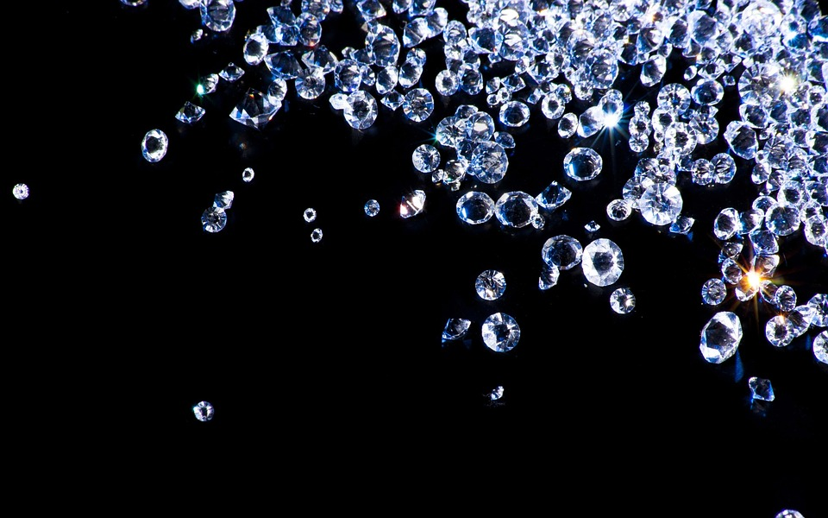
Diamond Price Predicting
Yawei Fei

Slide 2

Agenda
Background
Business Plan
Data Exploration
Business Context - Pricing / Recommendation
Regression Model (Linear / Ridge / Lasso / Random Forest)
Classification Model (Support Vector Machine)
Results and Findings
Future Prospect

Slide 3
Question???
What would you say is one of the most exciting moments in your life or that you can look forward to?
Notes:
Set up our business plan and idea

Slide 4
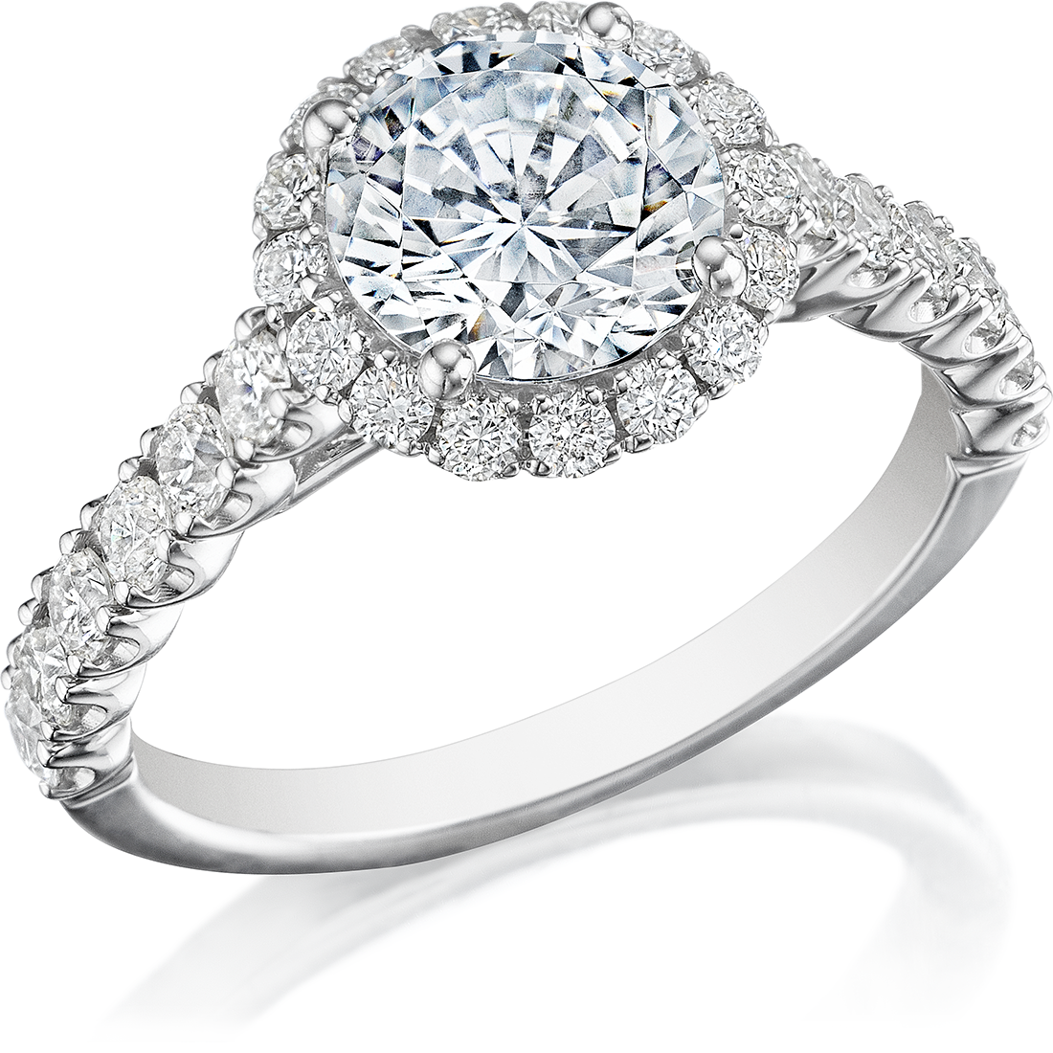
Dr. Murray’s Diamonds
DDDM
DMD
2019 Business Plan
Plan to open Summer 2019
Use Machine Learning to set our price
(Maximise Sales and Profits)
Want to predict a number
We need to build regression models
Personalized Recommendation
Classify our diamonds into price groups - (SVC)
To recommend to customers within their budget
Notes:
Price is one of the most important ways in which customers choose between different products and services, and knowing the optimum price that we should charge to maximise sales and profits is key to beating the competition.
As a new company, pricing our products is an important step before everything else. We want to use machine learning models to set our price.
In order to predict a number, we need to build regression models. We have built linear regression, ridge regression, lasso regression and random forest regression and compared the results to choose the best model.
In order to maximize our revenue, we need to classify our diamonds into several price groups and recommend to customers the group within their budget.
Built a Support Vector Classification Model
Machine Learning Jewelry Appraisal

Slide 5

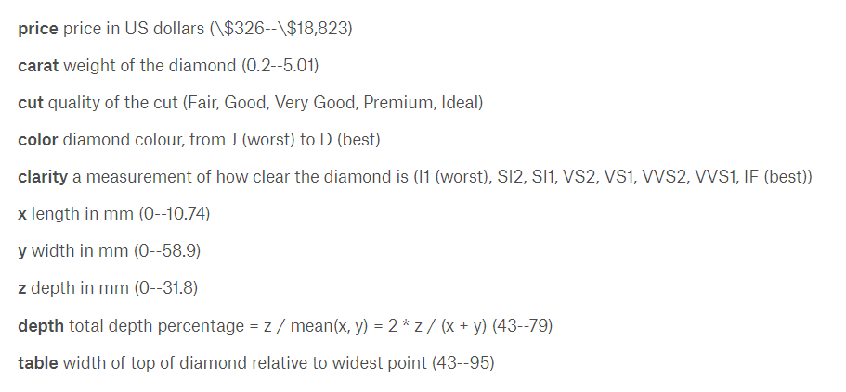
The Diamonds Dataset
53940 Observations of 10 Variables
Available for download from Kaggle: https://www.kaggle.com/shivam2503/diamonds

Slide 6
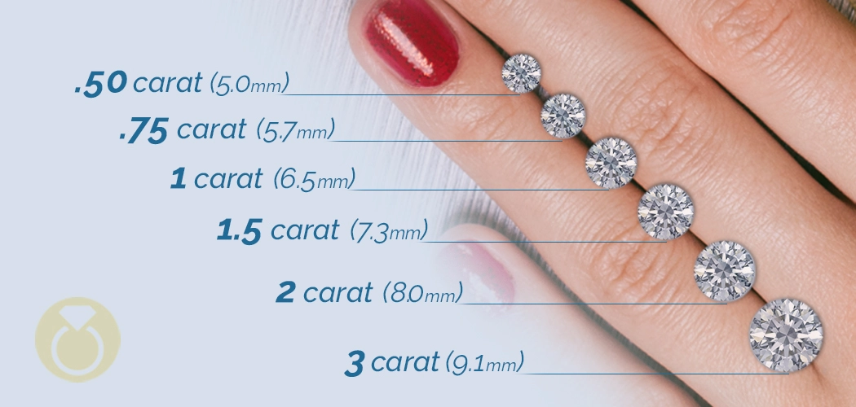
Carat
Measure of a gemstone’s mass
1 Carat = 200 mg

Slide 7
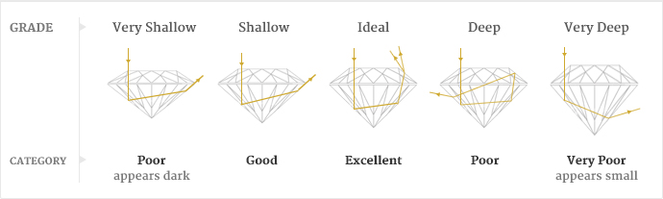
Cut
Notes:
http://pinar.kubkireklamowe.co/diamond-cut-chart/

Slide 8
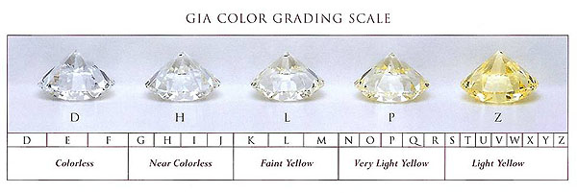
Color
Dataset contains only Colorless and Near Colorless (D - J)
Notes:
https://www.petragems.com/education/diamond-color/

Slide 9
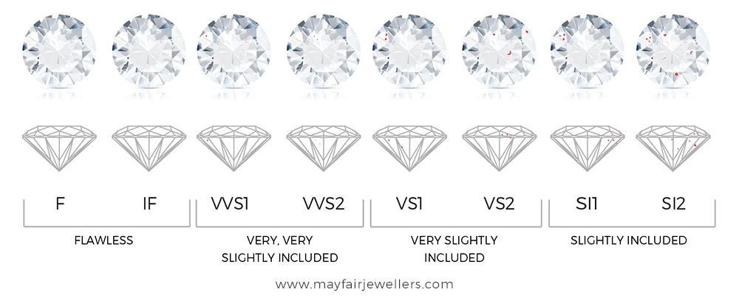
Clarity
Notes:
https://www.keygems.net/diamond-clarity-grading-by-gia/

Slide 10
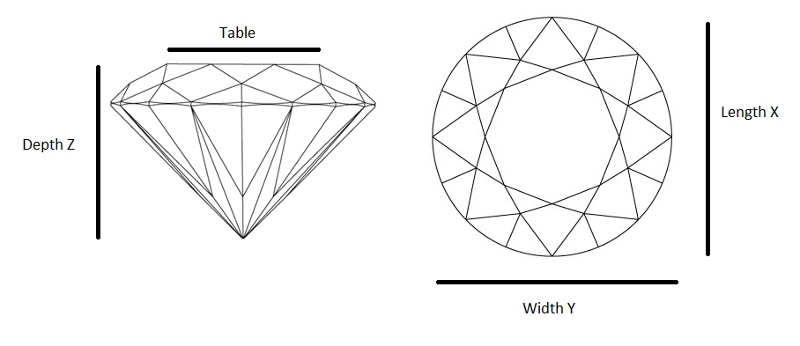
Diamond Quantification
Table: Table / Diameter %
Depth: Depth / Girdle Diameter %
Notes:
https://www.worthy.com/blog/diamond-spotlight/cut-grade-diamond-shape/

Slide 11
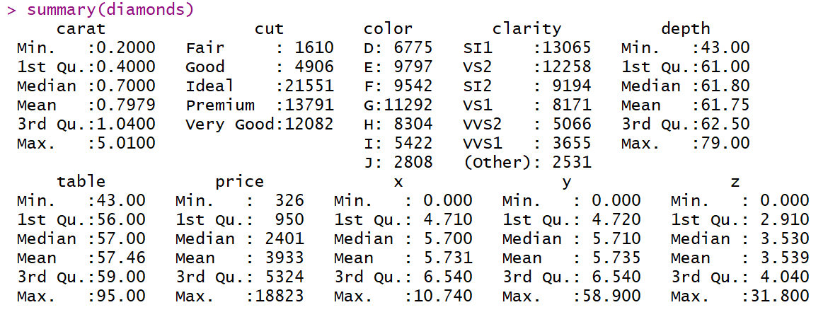
Data Exploration

Slide 12
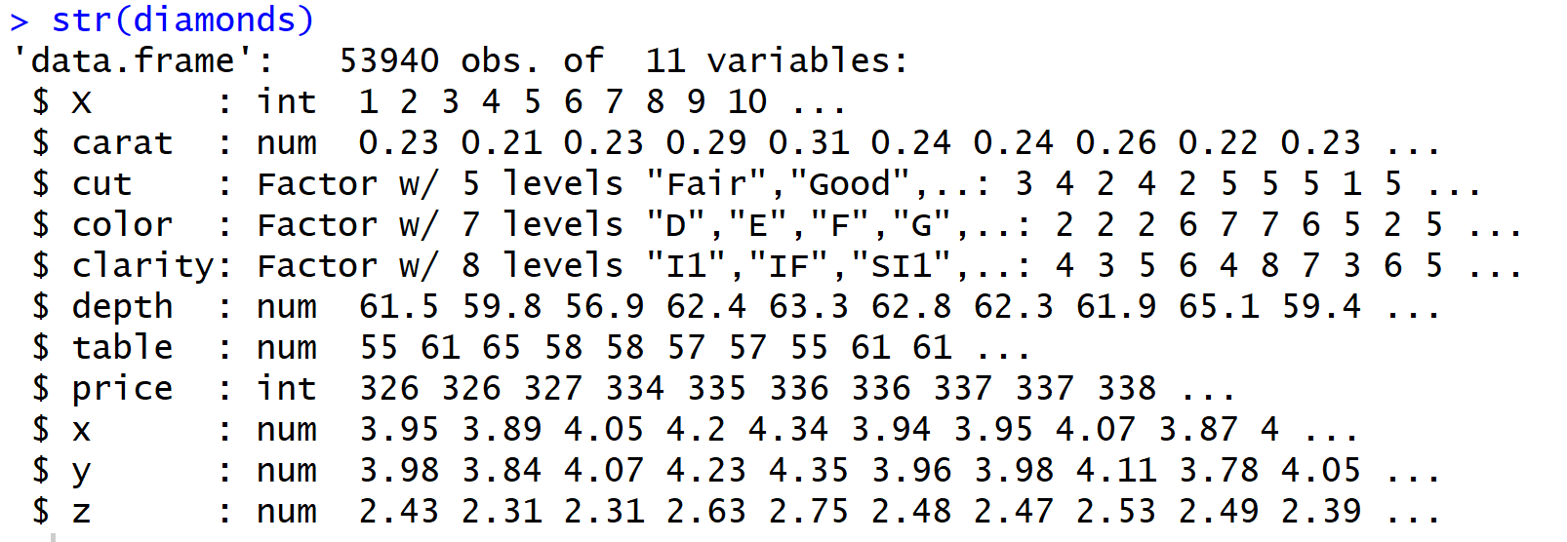
Data exploration

Slide 13
Data Preprocessing
Dropped the rowid column
Checked if there were missing values
Got rid of zero values - found 20 rows that had a 0 for:
x (length)
y (width)
Z (depth)
No such thing as a 2D diamond
Needed to convert our qualitative variables into dummy variables
Using Model.Matrix()
Scaled all the independent variables

Slide 14
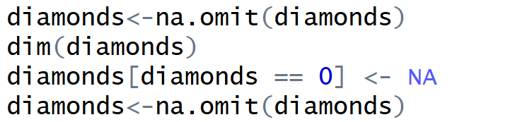
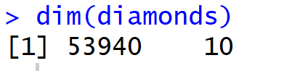
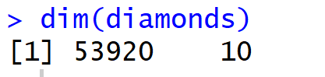
Data Cleansing
Notes:
Helping clean up our data with 0 values and removing them

Slide 15
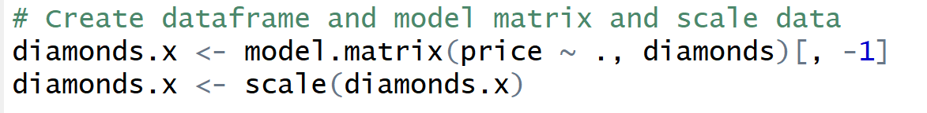
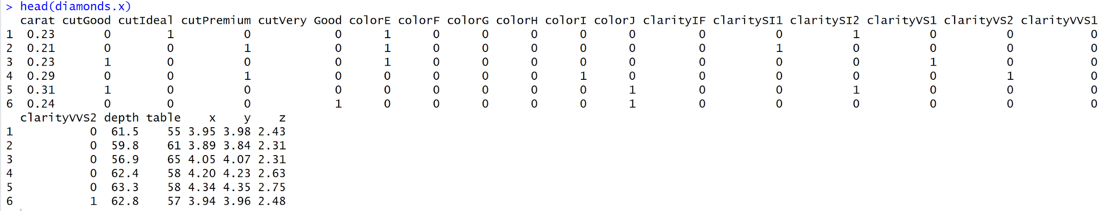
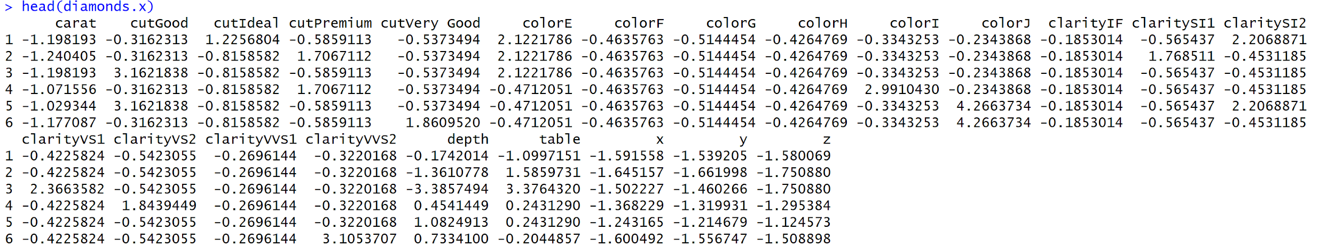
Notes:
Creating dummy variables for our qualitative variables

Slide 16
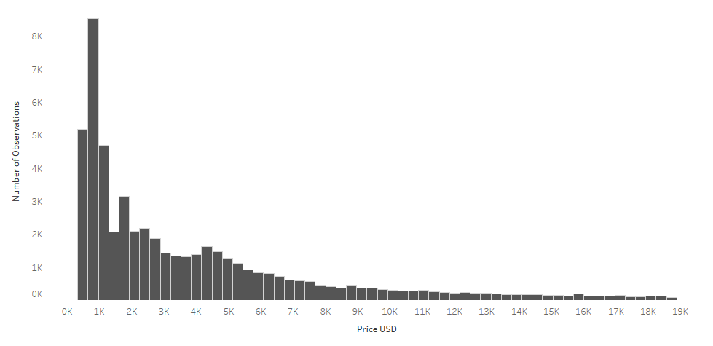
Diamond Price Distribution

Slide 17
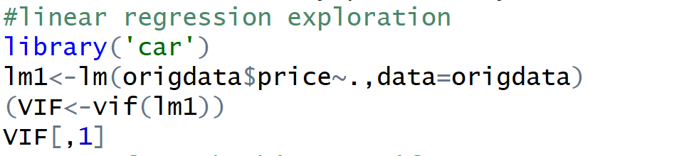
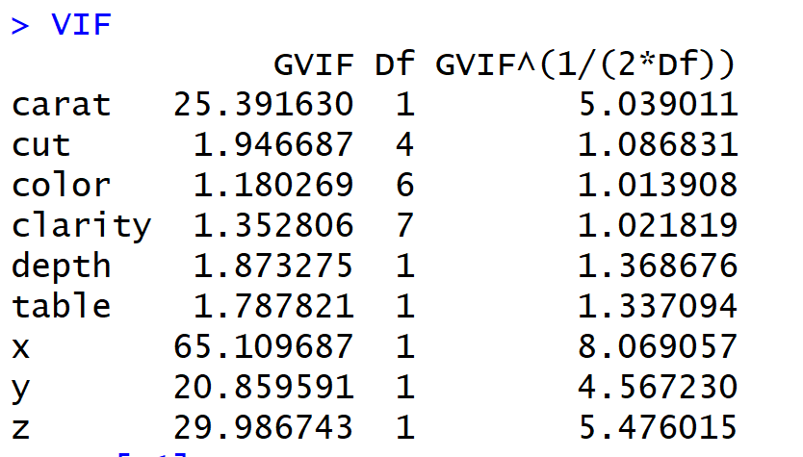
Our Models - Linear Regression
Use vif function in the ‘car’ package to experiment with collinearity
Remove variable with variable>5
Remove variable with the highest vif value first unitil there is no variable with vif value> 5

Slide 18
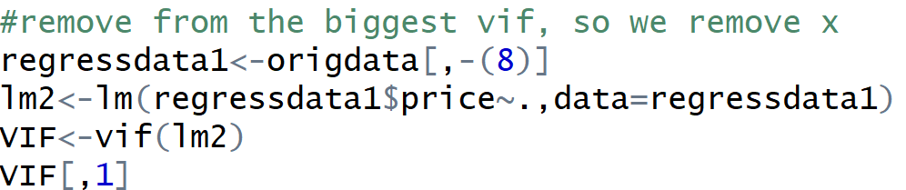
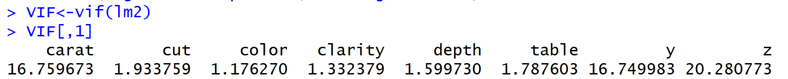
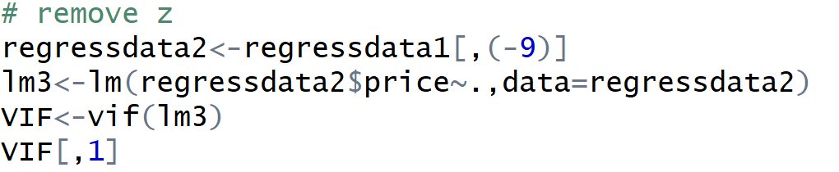
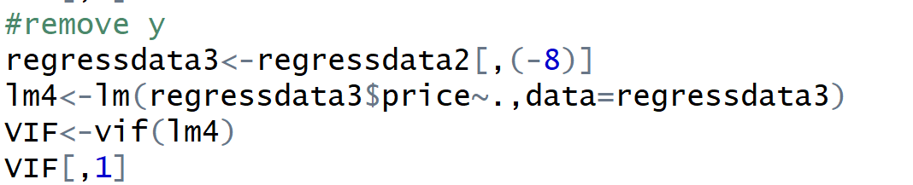
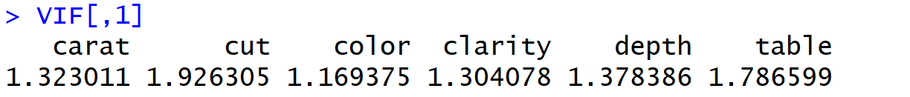

Slide 19
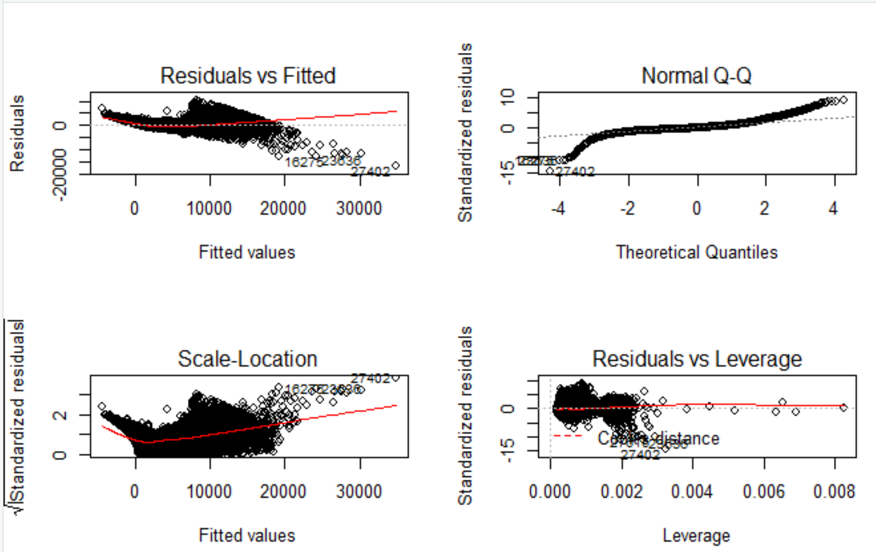

Slide 20
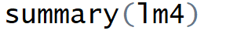
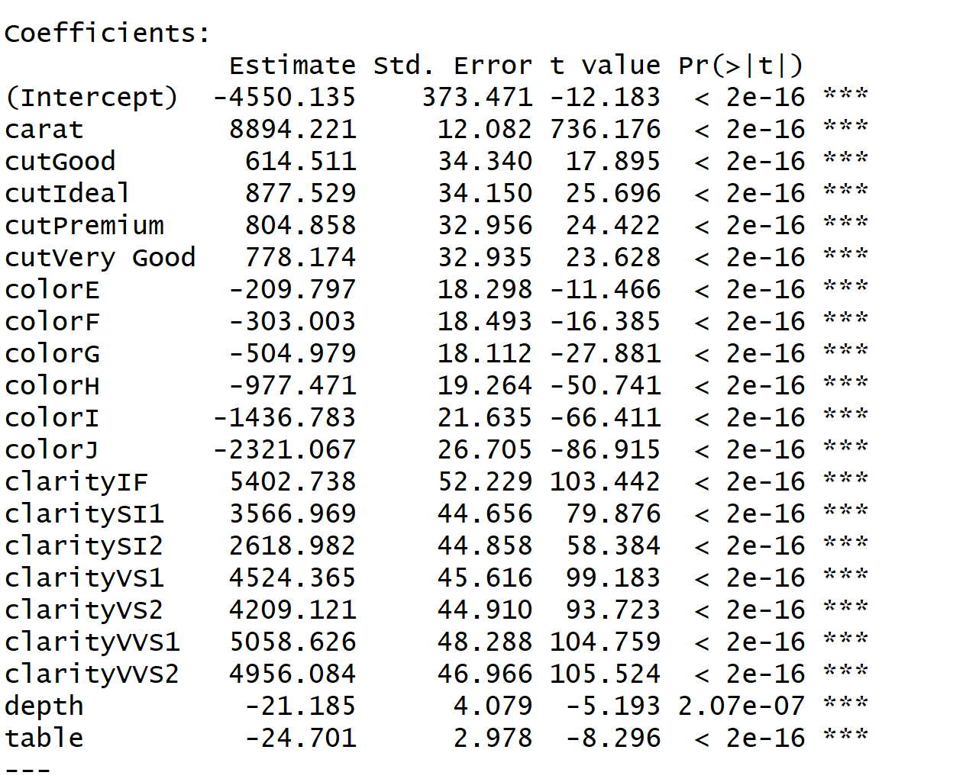
Here are too many high leverage points. It may because there are some price that is extremely high and our linear model largely underestimated their price
Also the standard residual value versus the fitted value has a pattern. It suggest that our model did not capture all the variables. Variables are missing in the data set we have.
We may need to gather other attributes that are related to predicting the diamond price
Train MSE | Test MSE
1344496 | 1296426

Slide 21
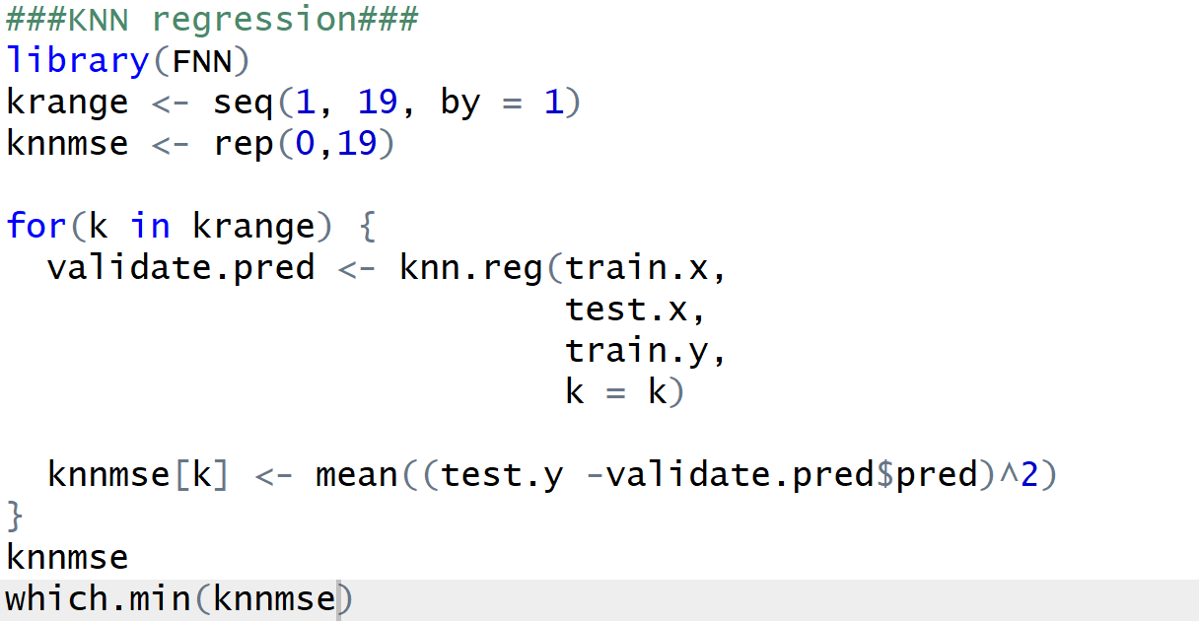
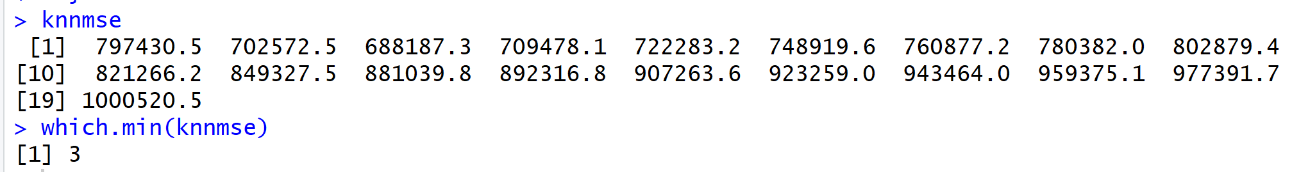
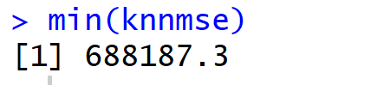
Our Models - KNN Regression

Slide 22
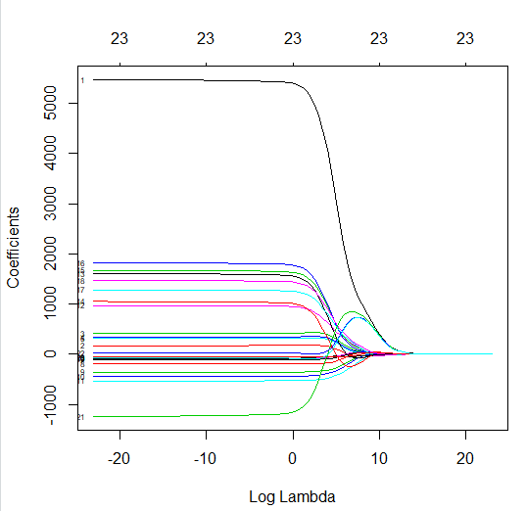
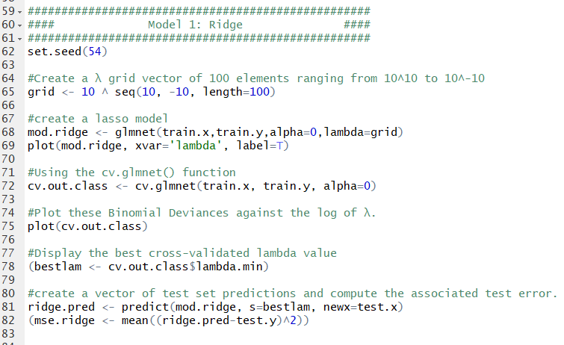
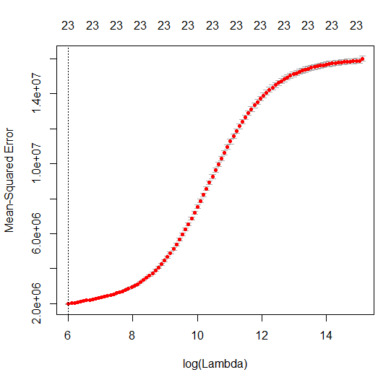
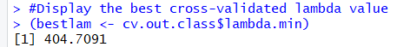
Our Models - Ridge Regression

Slide 23
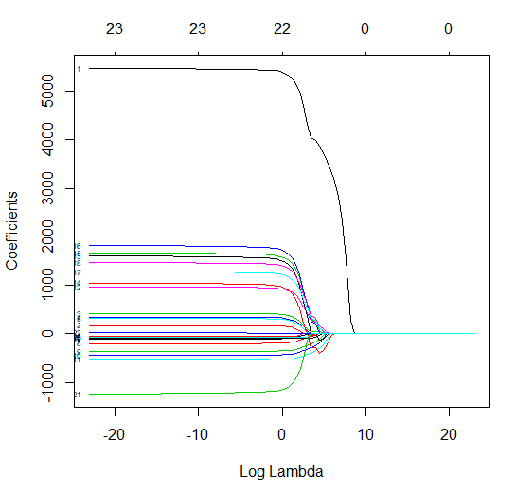
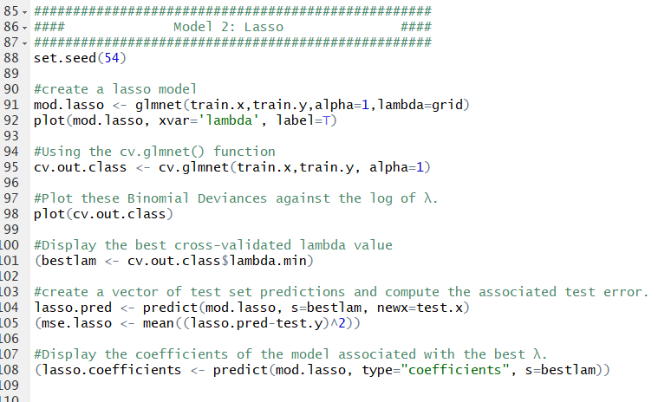
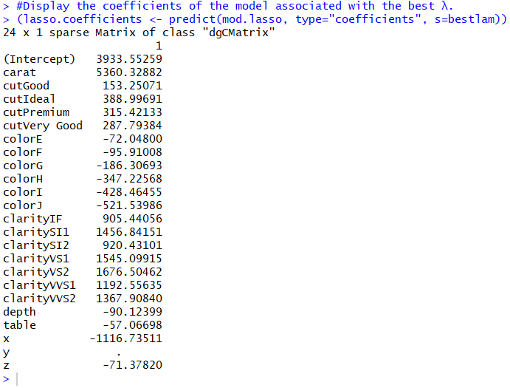
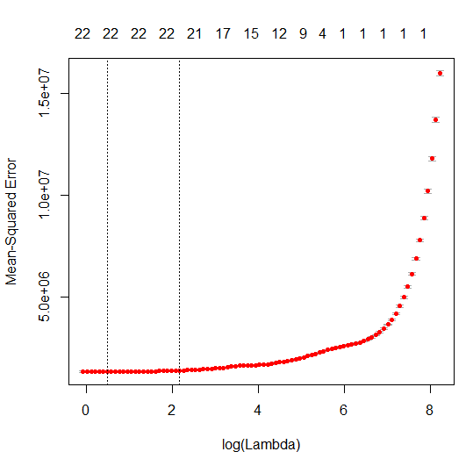
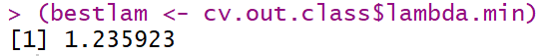
Our Models - Lasso Regression

Slide 24
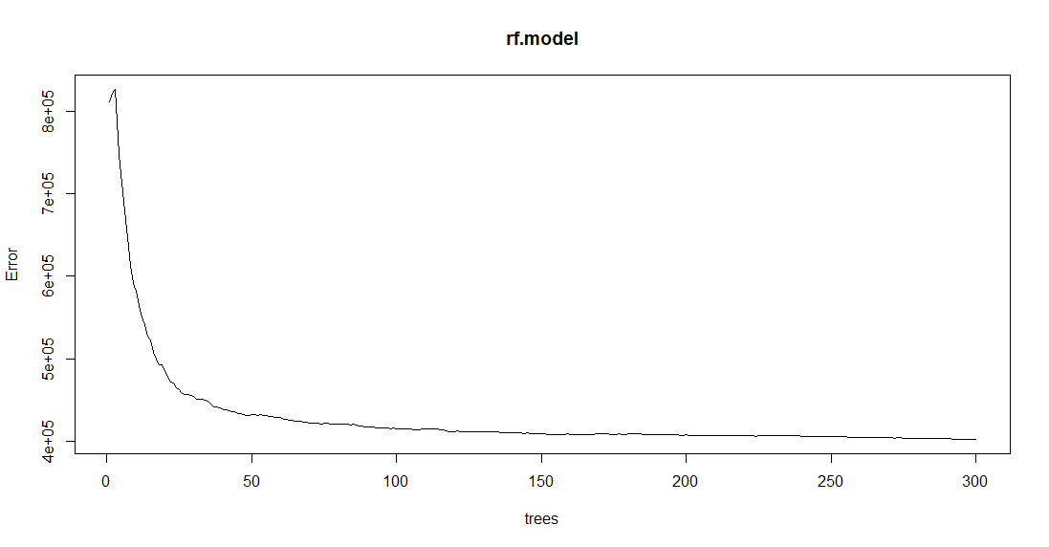
Our Models - Random Forest Regression
Build a Random Forest Regression Model with ntree = 300
ntree = 100

Slide 25
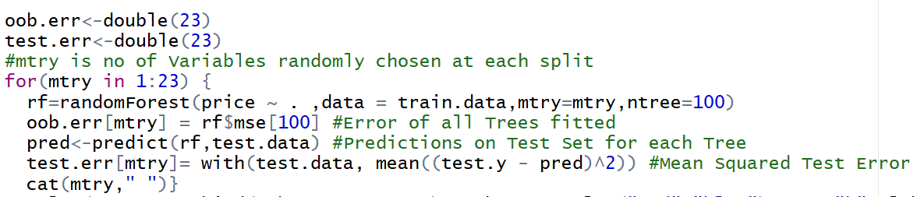
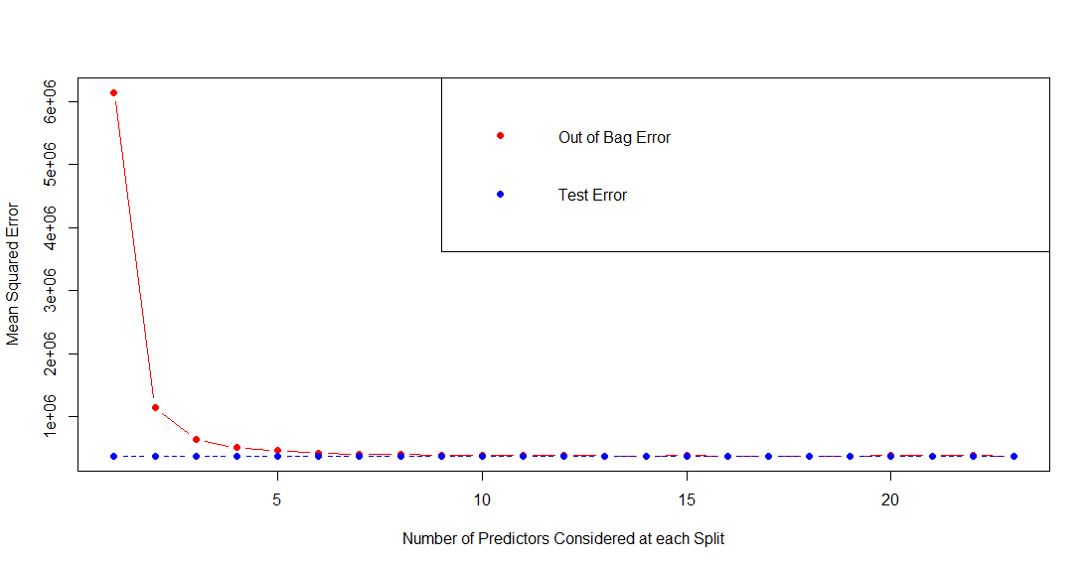
Our Models - Random Forest Regression
mtry = 4

Slide 26
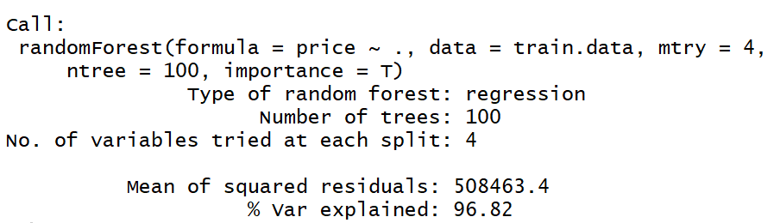
Our Models - Random Forest Regression
Build our final Random Forest Regression Model with mtry = 4 and ntree = 100

Slide 27
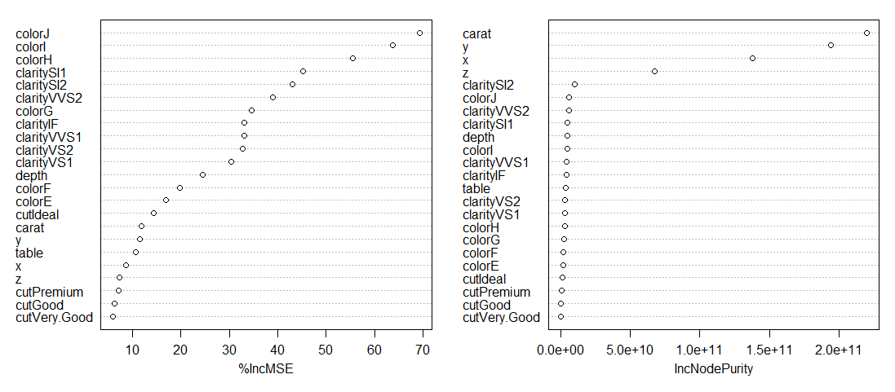
Our Models - Random Forest Regression

Slide 28
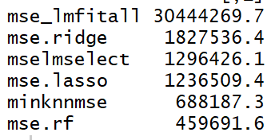
Comparison of Regression Models
Test MSE of our regression models
Choose Random Forest Model as our pricing model

Slide 29
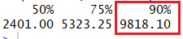
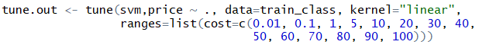
Support Vector Classification
Develop new line of diamond jewelry using only the finest
Classify diamonds in the top ten percent of price
Notes:
https://www.csie.ntu.edu.tw/~cjlin/papers/guide/guide.pdf

Slide 30
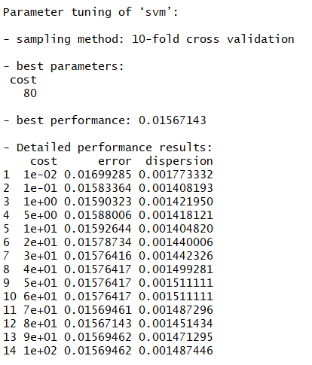
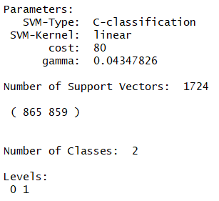

Slide 31
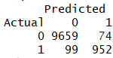

Support Vector Classification - Results
Model at cost = 80
SVC Model using Full Dataset
Correct Predictions | 98.40%
Error Rate | 1.60%
Type I Error | 0.76%
Type II Error | 9.42%
Correct Predictions | 98.48%
Error Rate | 1.52%
Type I Error | 0.81%
Type II Error | 7.84%

Slide 32

K-Means Clustering
Explore dataset for any distinguishable clusters
Issues with Clustering in R
Requires large amount of RAM for large datasets
Computationally intensive

Slide 33


Slide 34


Slide 35
Our Results and Findings
Regression Findings:
Choosing Random Forest to help price our model
Classification Findings:
Track high-end diamond sales to better manage inventory
Analyze customers who purchase high-end diamonds
So salespersons can recognize customers more likely to spend more
Introduce new line of high-end diamond jewelry: Brilliance by Murray
Notes:
Regression is helping pricing our products and the classification is helping us to target the specific customer and identify the diamonds that are going to be the most expensive ones

Slide 36






Notes:
Things to consider for next time
Specific diamond Shape (Round, Pear, Princess, Emerald, etc.)
A more diverse dataset (more options for the Cut, Clarity, Color)
Our Dataset didn’t include diamonds that had all the attributes from these variables

